Slide 1


Presidency
Presidency
School of Artificial Intelligence and Advanced Computing

Slide 2
Unified Security Scanner + RAG Assistant
CSS7102- Mini Project Review-2
Batch Number : CCS_13
Under the Supervision of,
Dr. Sampath A K
Head of the department (cyber security)
School of Computer Science and Engineering
Presidency University
Roll Number | Student Name
20231CCS0117 20231CCS0125 20231CCS0116 20231CCS0173 | Roopashree M Mohammed Rayyan Khan Shreya Syeda Zaiba
Name of the Program: CCS-Computer Science & Engineering (Cyber Security)
Name of the HoD: Dr. Sampath A K
Name of the Program Project Coordinator: Dr . Sampath A K
Name of the School Project Coordinators: Dr. Sampath A K

Slide 3
Content
Abstract
Literature Survey
Objectives
Existing Methods and Drawbacks
Proposed Methods Feasibility Study
Architecture diagram
Modules
Hardware and software
Timeline
References

Slide 4
Abstract
With the increasing number of cyber threats, organizations require efficient tools to identify vulnerabilities in their systems. However, existing security assessment tools such as Nmap and Nuclei operate independently, requiring users to switch between different tools and manually analyze separate outputs.
The proposed Unified Security Scanner integrates multiple open-source security scanners into a single web-based platform. The system currently supports Nmap for network scanning and Nuclei for vulnerability assessment. Users can initiate scans through a simple web interface, while the backend executes the selected scanner and displays standardized results in a unified dashboard.

Slide 5
Literature Survey
Paper | Contribution
A Systematic Literature Review on Web Vulnerability Scanners | Reviews existing vulnerability scanners
Web-based Reconnaissance and Vulnerability Scanner | Proposes integrated vulnerability assessment
Evaluation of Security Vulnerability Scanners | Compares Nmap, Nessus, OpenVAS
A Comprehensive Detection Approach of Nmap | Explains Nmap scanning principles
Automation of Nmap Scanning | Automates Nmap execution
Network Monitoring and Enumerating Vulnerabilities | Network vulnerability assessment
Systematic Method for Network Scanning | Penetration testing using Nmap
Impact of Penetration Testing | Security assessment challenges
Detecting Network Security Vulnerabilities | Threat identification methods
Improving Productivity in Nmap Security Audits | Enhances Nmap usability

Slide 6
Objectives
Primary Objective
Develop a unified web-based vulnerability assessment platform.
Specific Objectives
Integration of multiple scanners for any web application vulnerabilities
Display standardized scan results.
Improve usability for beginners.
Provide an extensible architecture for future scanners

Slide 7
Existing Methods and Drawbacks
Existing Tools
Nmap
Nuclei
Nessus
OpenVAS
Drawbacks
Separate installation
Different command syntax
Different report formats
Manual analysis
No centralized interface

Slide 8
Proposed Methods
Develop a web-based Unified Security Scanner.
Provide a single interface for multiple security scanners.
Accept user input (scanner selection and target).
Execute the selected scanner through the FastAPI backend.
Parse scanner outputs into a common format.
Display vulnerability details in a unified dashboard.

Slide 9
Feasibility Study
Technical Feasibility
ReactJS
FastAPI
Python
Multiple scanners
Operational Feasibility
Easy to use
Minimal user training
Simple deployment

Slide 10
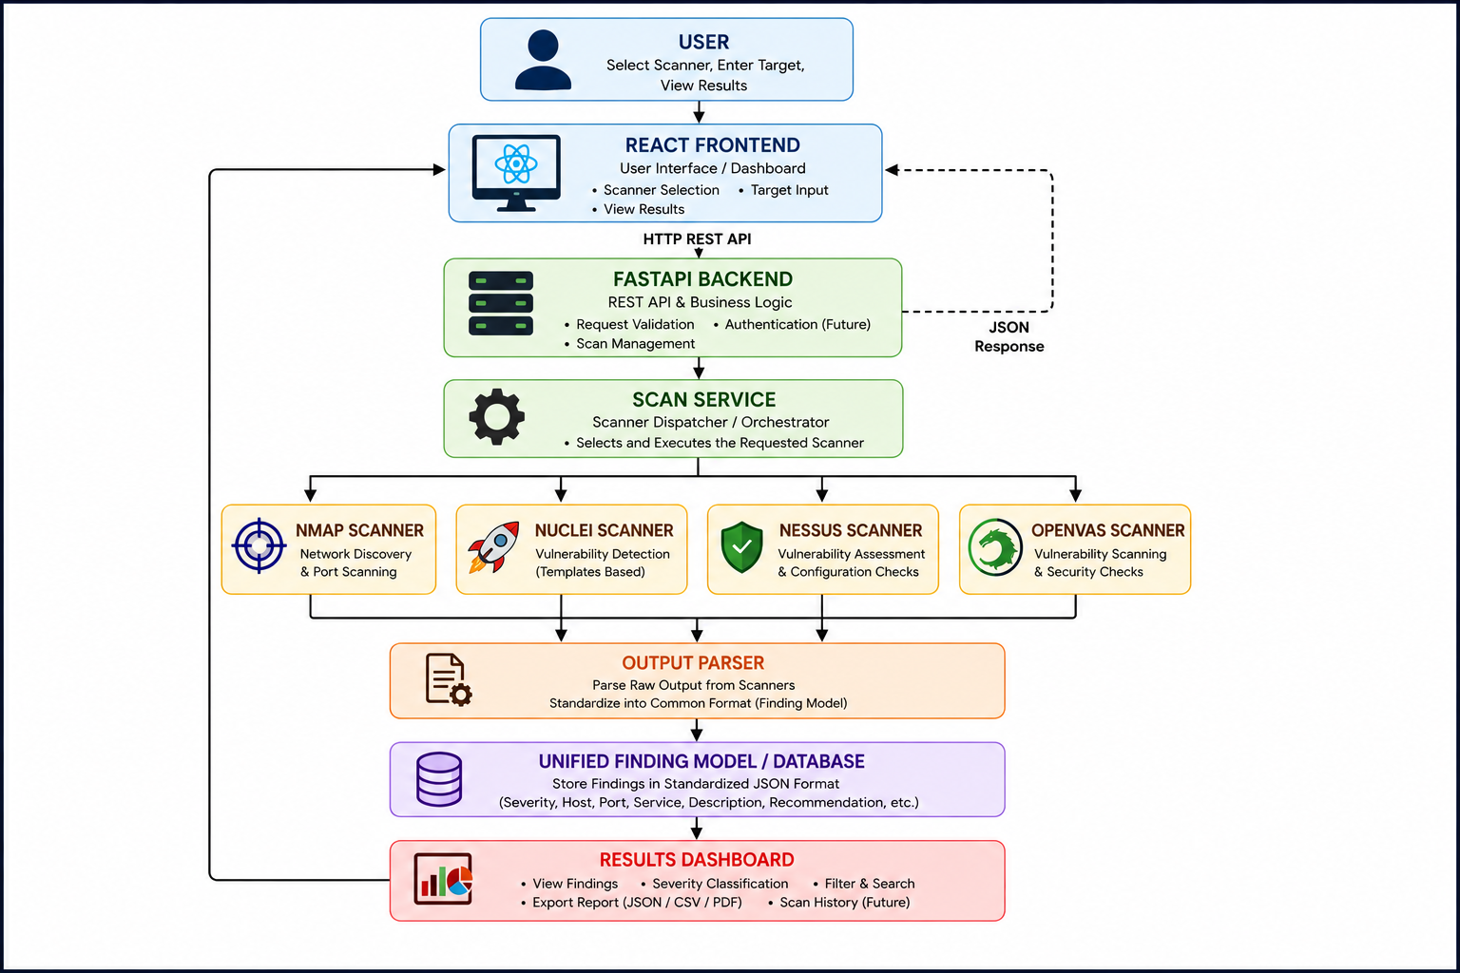
System Architecture

Slide 11
Modules
Module 1 - Frontend
User Interface
Scanner Selection
Target Input
Module 2 -Backend
REST API
Request Validation

Slide 12
Modules
Module 3 - Scanner Integration
Nmap
Nuclei
Nessus
OpenVAS
Module 4 - Output Processing
Parse scanner output
Standardize findings
Display vulnerabilities and Severity
Description

Slide 13
Hardware & Software
Hardware
Intel Core i5 Processor
8 GB RAM
Windows 11
Software
Python 3.12
FastAPI
ReactJS
MySQL
Large Language Model
Github

Slide 14
Timeline of the Project (Gantt Chart)
Activity | W1 | W2 | W3 | W4 | W5 | W6 | W7 | W8 | W9 | W10
Literature Survey & Research | █ | █
Requirement Analysis |  | █ | █
Architecture Design |  |  | █ | █
Frontend & Backend Development |  |  |  | █ | █ | █
RAG & AI Integration |  |  |  |  | █ | █ | █
Testing |  |  |  |  |  |  | █ | █
Documentation |  |  |  |  |  |  |  | █ | █
Final Review |  |  |  |  |  |  |  |  |  | █

Slide 15
References
1. Automation of Nmap Scanning of Information Systems
https://ieeexplore.ieee.org/document/10496014
2. Web-based Reconnaissance and Vulnerability Scanner: A Review and Proposed Solution
https://ieeexplore.ieee.org/document/9655963
3. A Comprehensive Detection Approach of Nmap: Principles, Rules and Experiments
https://ieeexplore.ieee.org/document/9329410
4. Evaluation of Security Vulnerability Scanners for Small and Medium Enterprises Business Networks Resilience Towards Risk Assessment
https://ieeexplore.ieee.org/document/8873438
5. Research on the LLM-Driven Vulnerability Detection System Using LProtector
https://ieeexplore.ieee.org/document/10859408
6. Enriching IP Scanning Results with Structured Threat Intelligence Toward Actionable Reconnaissance in Cybersecurity Operations
https://ieeexplore.ieee.org/document/11208493
7. Vulnerability Management Chaining: An Integrated Framework for Efficient Cybersecurity Risk Prioritization
https://ieeexplore.ieee.org/document/3665768
8. IoT-Scan: Network Reconnaissance for Internet of Things
https://ieeexplore.ieee.org/document/10299538
9. A Comparative Analysis of Port Scanning Tool Efficacy
https://ieeexplore.ieee.org/document/10339885
10. RAGSec: Retrieval-Augmented Generation for Cybersecurity Threat Intelligence in Enterprise Networks
https://doi.org/10.1109/ICAIC67076.2026.11395762

Slide 16


